Slide 1

Azure Key Vault

Slide 2
Solve problems
Secrets Management
Securely store and control access to Tokens, Passwords, Certificates, API keys and Other secrets
Key Management
Create and control the encryption keys used to encrypt your data
Certificate Management
Provision, manage, and deploy public and private Transport Layer Security/Secure Sockets Layer (TLS/SSL) certificates

Slide 3
Why use Azure Key Vault?
Centralize application secrets
Securely store secrets and keys
Monitor access and use
Simplified administration of application secrets

Slide 4
Keys vs Secrets
Key
A Cryptographic key represented as JWK (JSON Web Key).
Example: store A .pfx certificate file that contains a pair of public & private keys
Secret
Key Vault accepts any value and stores it as a binary.
Example: A password or API key

Slide 5
Hands-On: Key Vault

Slide 6
Managed Identity

Slide 7
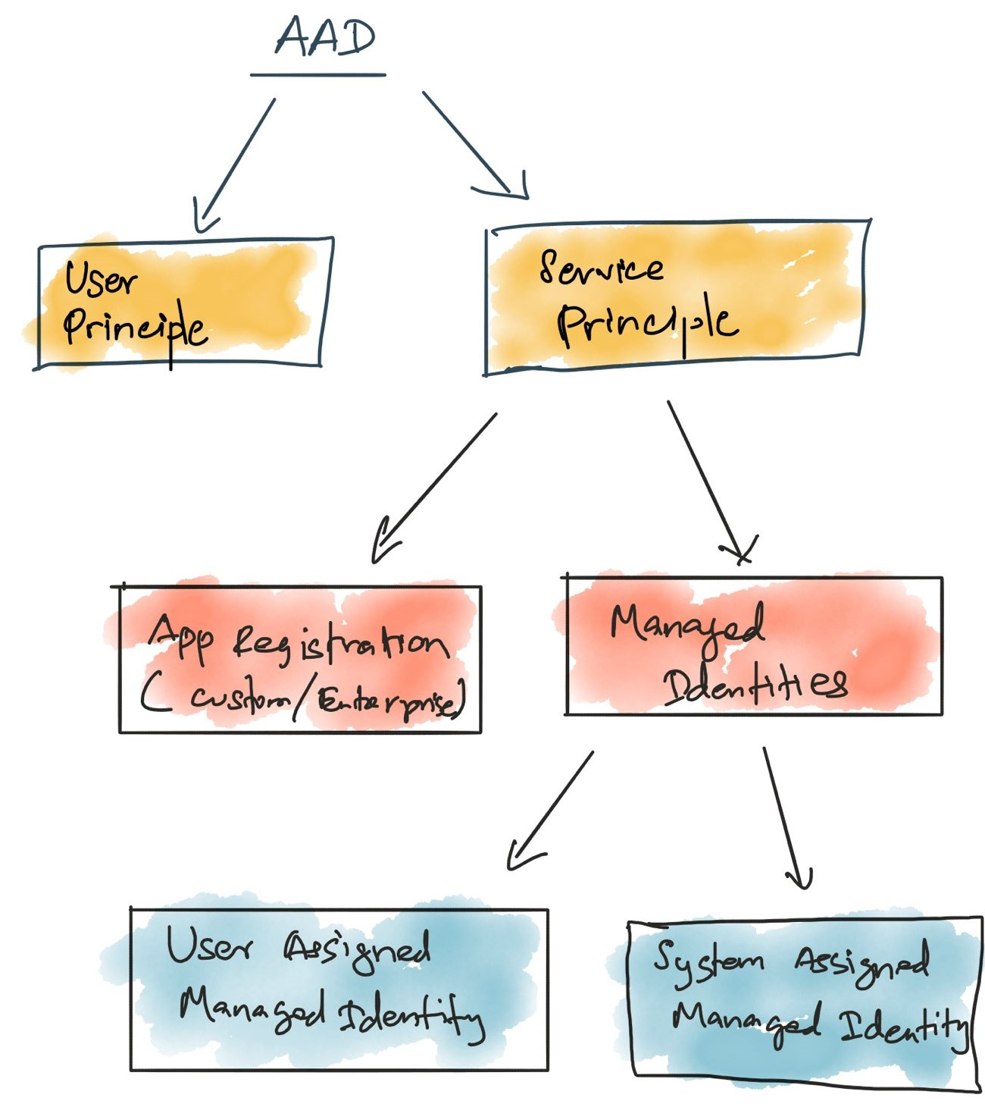
AAD Principle

Slide 8
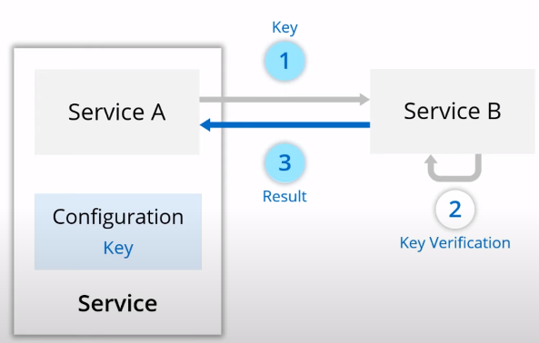
The Problem

Slide 9
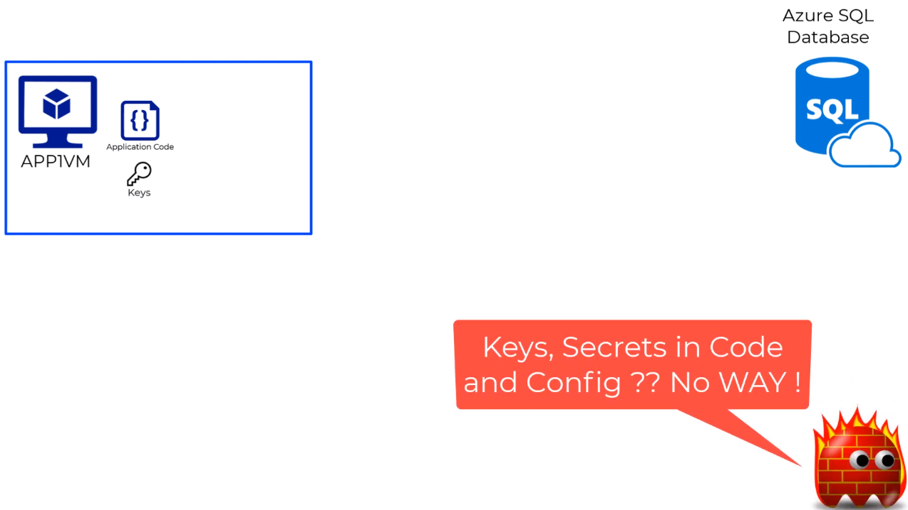
The Problem

Slide 10
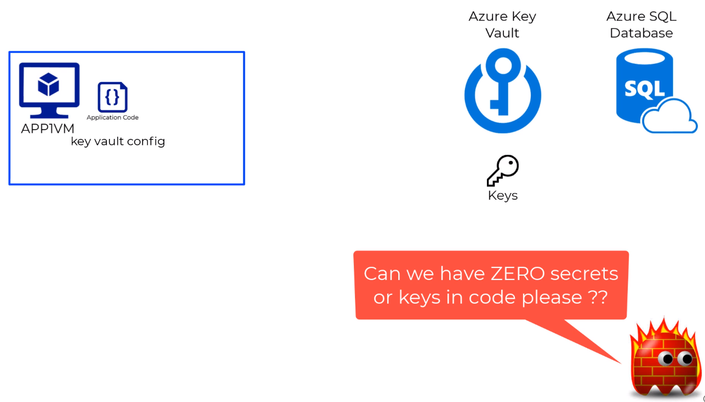

Slide 11
Solution: Managed Identities
Characteristics
Credentials are moved out of application code
Identity created and tied with resource lifecycle
Managed Identities are Service Principals of special type
Auditable
Can be assigned and revoked from individual resources

Slide 12
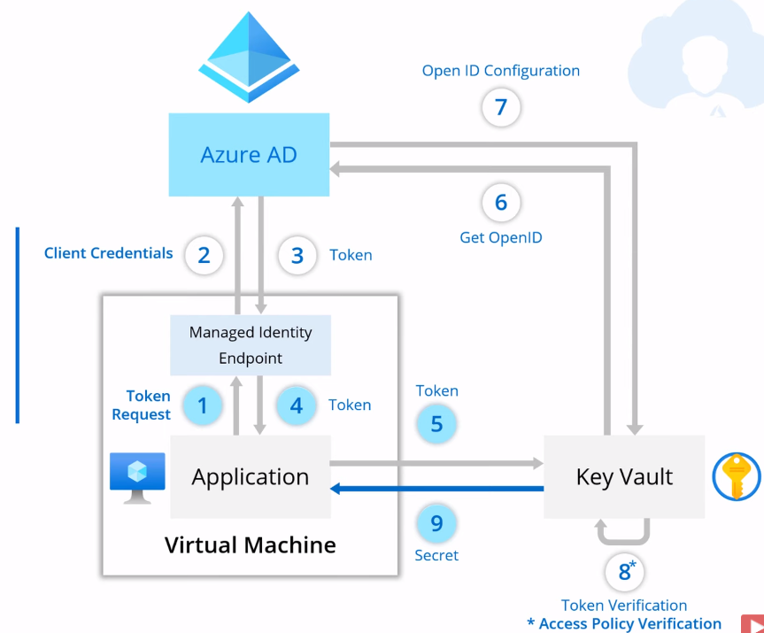
Managed Identities – Solving Challenges
Internal Endpoint
No Credentials in the code
Identity name is the same as resource name
Identity lifecycle is tied to resource

Slide 13
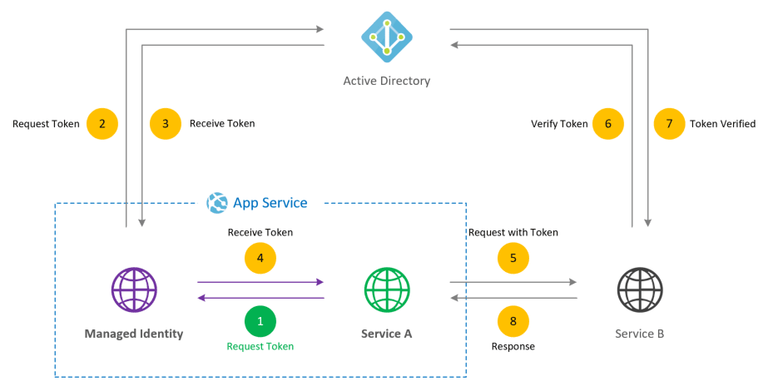
Managed Identities – Solving Challenges

Slide 14
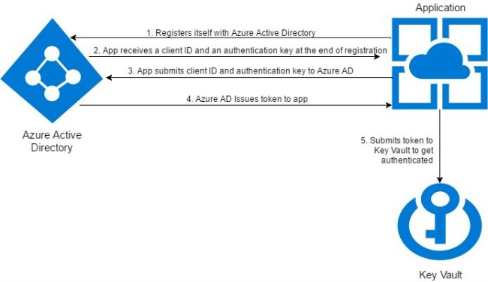
Managed Identities – Solving Challenges

Slide 15
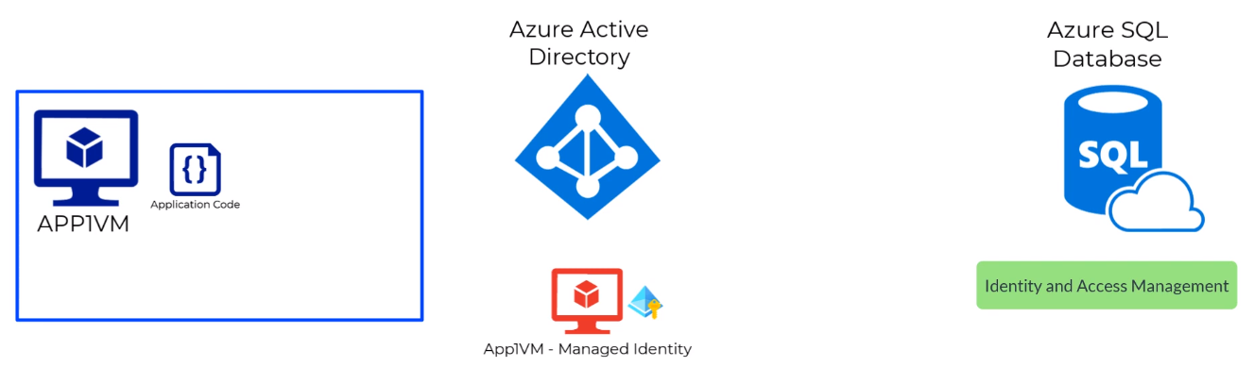
Managed Identities Enabled

Slide 16
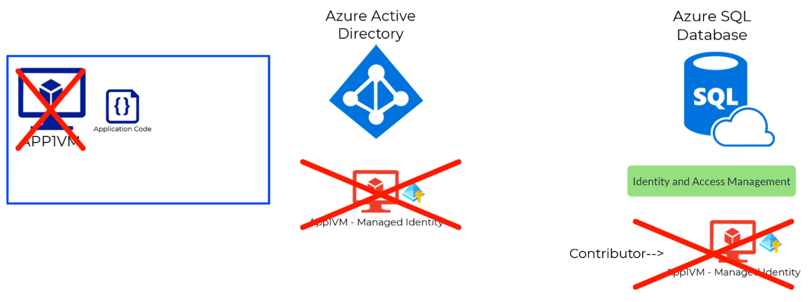
Auto Deleted if VM is Deleted

Slide 17
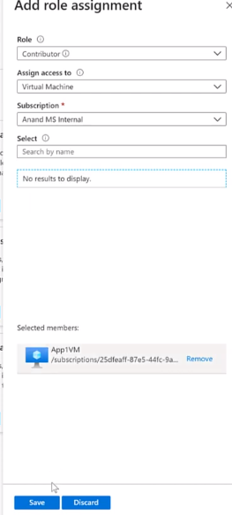
Hands-On: System Assigned Managed Identity
Step 1: Create Data Factory
Managed Identity for Data Factory is auto created
Step 2: Grant Access to the Identity
Open Target Resource (SQL Server) which is to be access securely
Open IAM
Grant Permission to Managed Identity
Role: Reader
Now data factory can access SQL Server

Slide 18
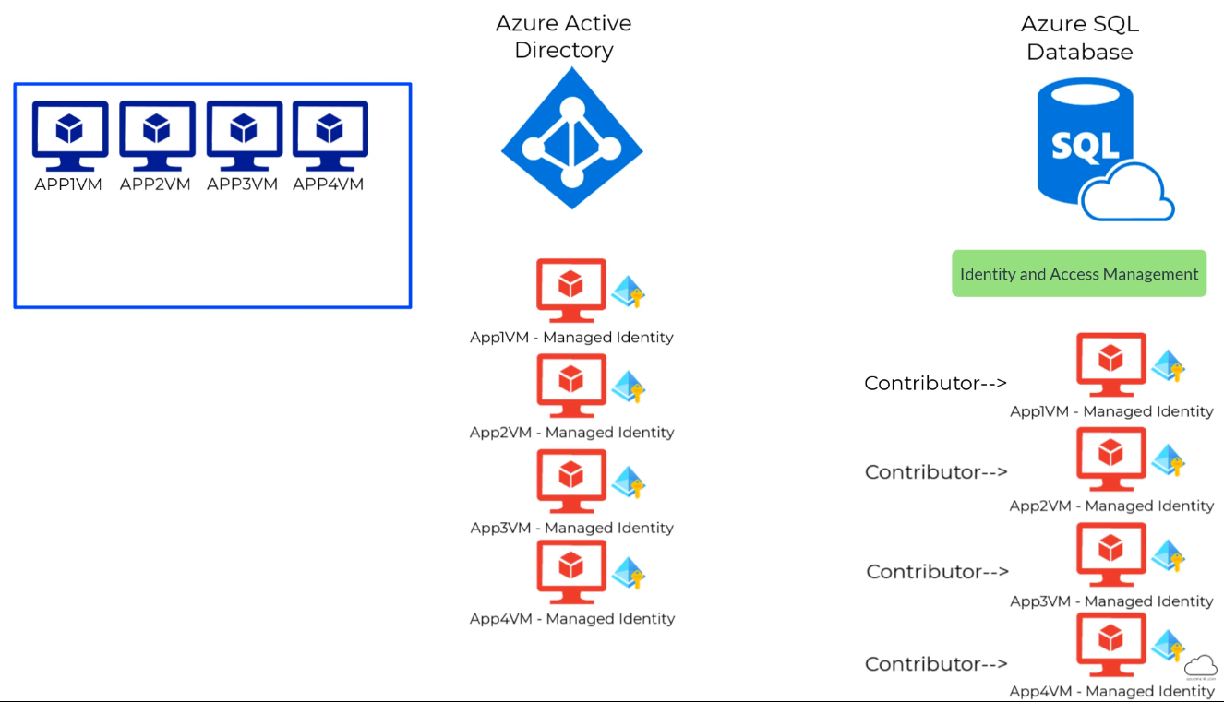
Becomes unmanageable if VMs increases

Slide 19
Azure Key Vault Security and Best Practices
Control Access to your vault
Lock down access to your subscription, resource group and Key Vaults (RBAC)
Create Access policies for every vault
Use least privilege access principal to grant access
Turn on Firewall and VNET Service Endpoints
Use separate Key Vault
Use a vault per application per environment
Backup
Use Logging from Monitoring Section
Turn on recovery options
Turn on Soft Delete.
Turn on purge protection

Slide 20


